Slide 1
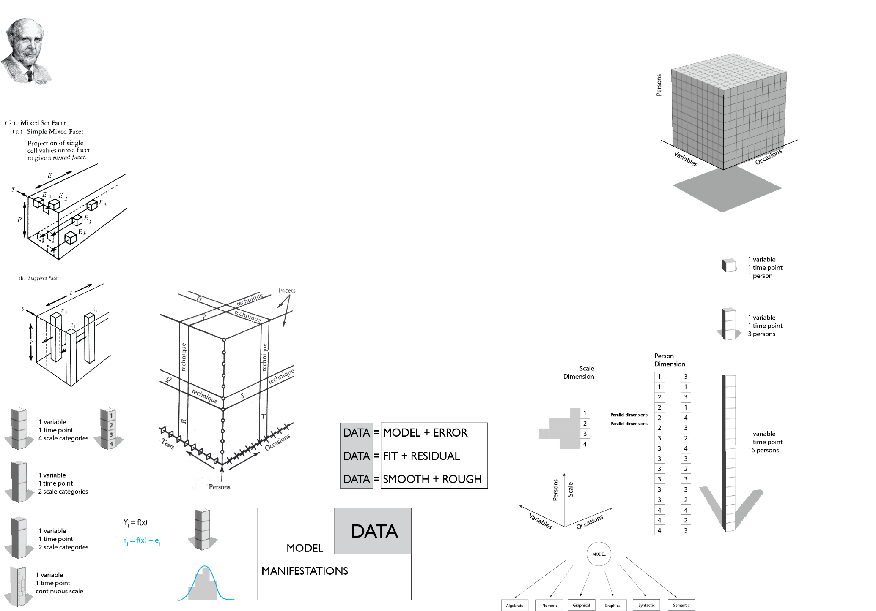
Imagining an interface
for
Statistical modeling
January 19, 2015
University of Victoria
Andriy V. Koval
Notes:
Hi, my name is Andriy Koval. I recently graduated with a degree in QUANTand have been a post doc researcher here since August. Today I’d like to tell you about one of the ideas that shaped my present academic interests.

Slide 2

Statistical modeller at work
Attention span
Levels of abstraction
Visual processing
Mental space architecture
Concept management
Notes:
A few years ago I reflected on the fact that statistical modelers routinely face various cognitive limitations in their work. Hardware and software technologies do assist our thinking, but we also employ TECHNOLOGIES OF THE MIND or MENTAL DEVICES: taxonomies, systems, frameworks, mnemonics, paradigms.

Slide 3
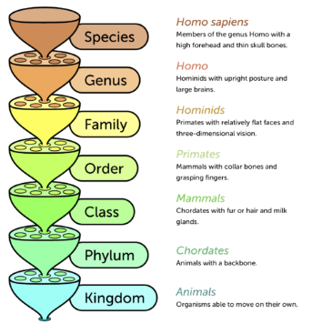
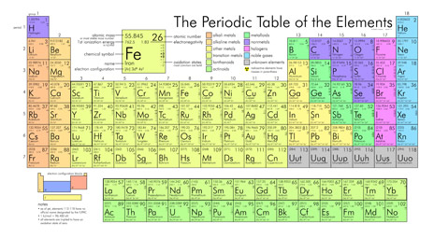
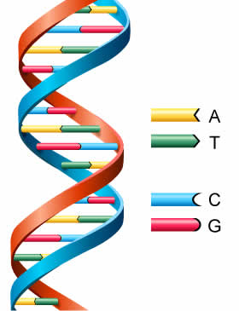
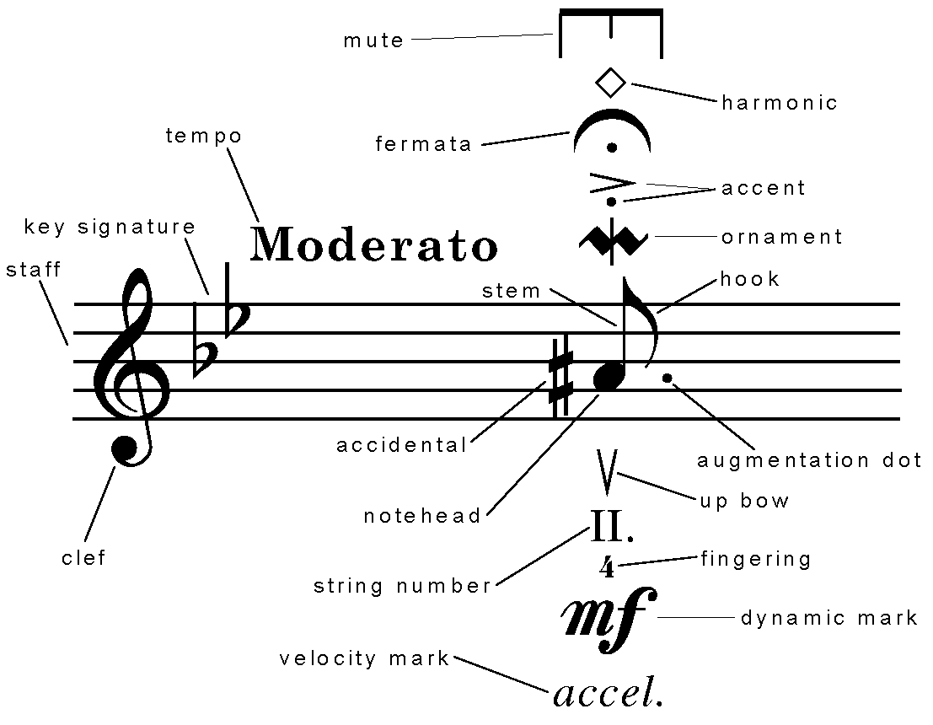

Biology
Chemistry
Genetics
Music
Linguistics
Statistical Modeling
?
Notes:
As I looked around, I saw many examples of such mental devices in other fields of knowledge. They helped scientists 1-2) ORGANIZE knowledge 3) EVALUATE a particular type of information. Or 3) PERFORM certain mental tasks with lesser strain greater accuracy. Naturally, I wondered what such mental device could be for statistical modeling.

Slide 4
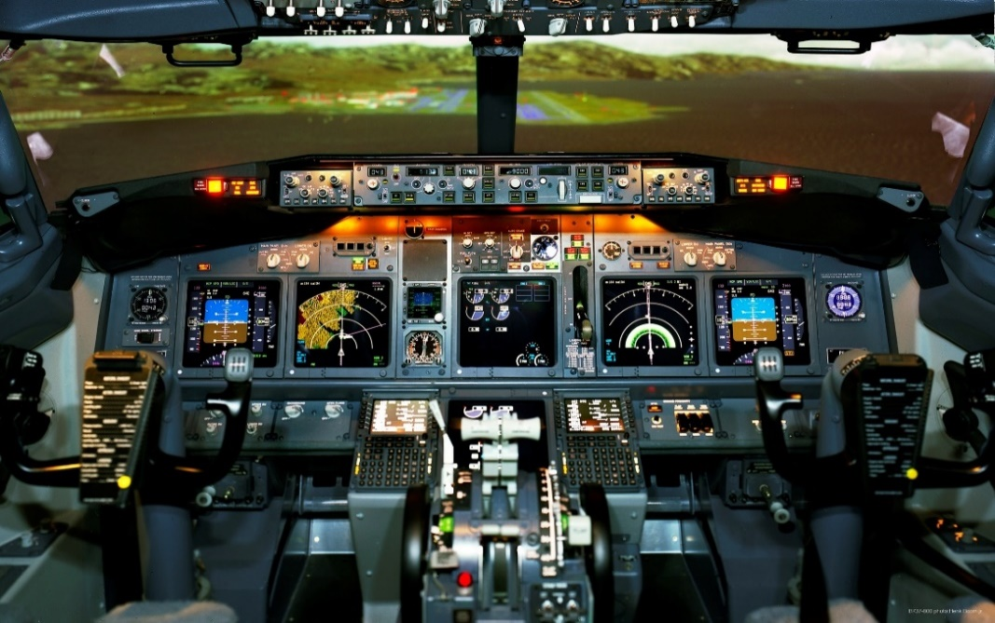
Interface for flying
Operations with concepts of
speed, azimuth, yaw, roll, pitch
?
Interface for modeling
Operations with concepts of
fit, significance, parsimony
Notes:
The complexity of decisions in statistical modeling – I thought – could be compared to flying a jet.

Slide 5
Interface for flying
Operations with concepts of
speed, azimuth, yaw, roll, pitch
Framework?
Discipline?
Software?
Data Types?
Interface for modeling
Operations with concepts of
fit, significance, parsimony

Slide 6
Models are becoming more
Complex
Sophisticated
Numerous

Slide 7




MODEL:
int by timec1@1 timec2@1 timec3@1 timec4@1 timec5@1
timec6@1 timec7@1 timec8@1 timec9@1 timec10@1 timec11@1;
linear by timec1@0 timec2@1 timec3@2 timec4@3 timec5@4
timec6@5 timec7@6 timec8@7 timec9@8 timec10@9 timec11@10;
Proc MIXED;
class id;
model attend = timec/
solution;
random INTERCEPT timec/
SUB=id TYPE=UN G;
[timec1-timec11@0]; timec1-timec11;
[int linear]; int linear;
int with linear;
model <-lmer (attend ~ 1 + timec + (1 + timec | id))
MIXED attend WITH timec
/FIXED= INTERCEPT timec timec2
/RANDOM= INTERCEPT timec | SUBJECT(id)
COVTYP(UN)

Slide 8
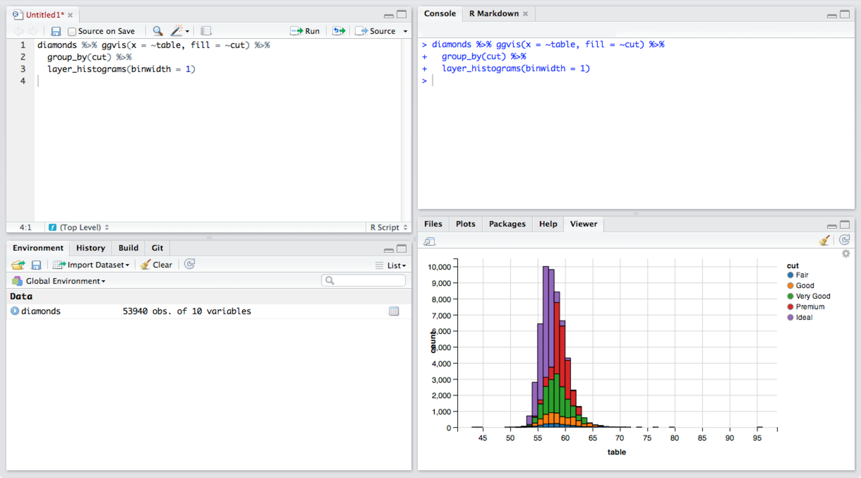

Slide 9
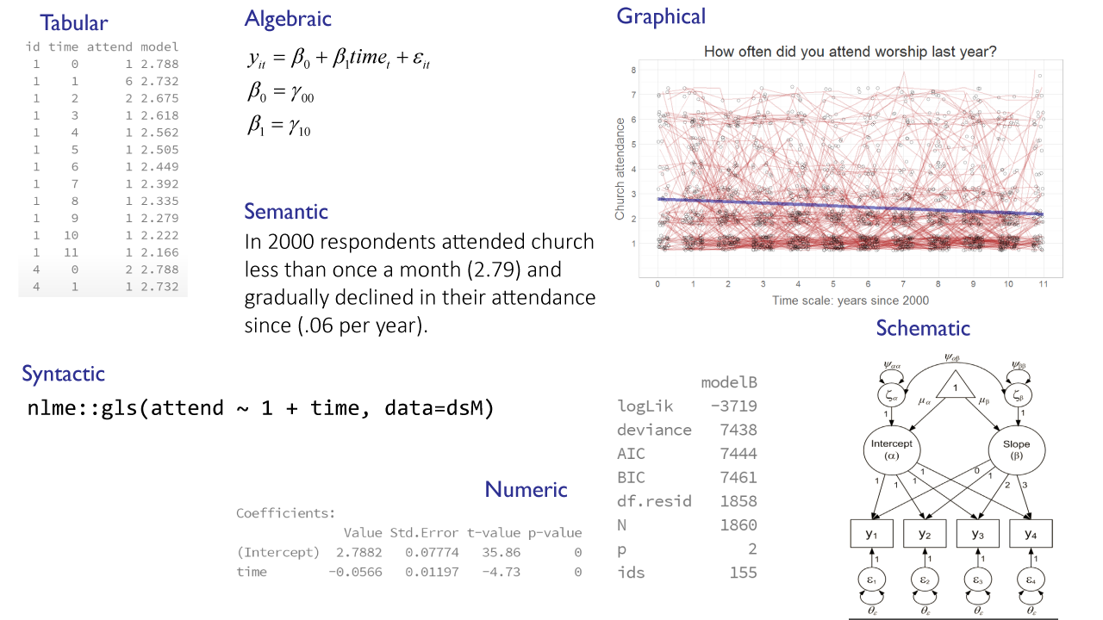
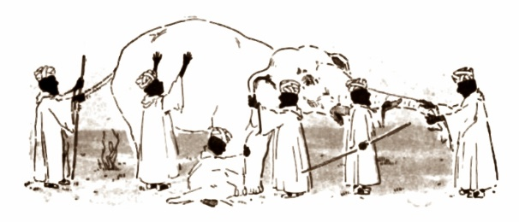

Slide 10
Scientists make digital art by combining model manifestations to tell stories about data

Slide 11
Meaning
cells → tissues
How do models comprise a meaning?
cells → tissue
Model
How do variables comprise a model?
molecules → cell
Data
How do data comprise the variable?
atoms → molecule
Notes:
In particular, they tell THREE STORIES:
Measured and processed
How model is specified and estimated
How models compare

Slide 12
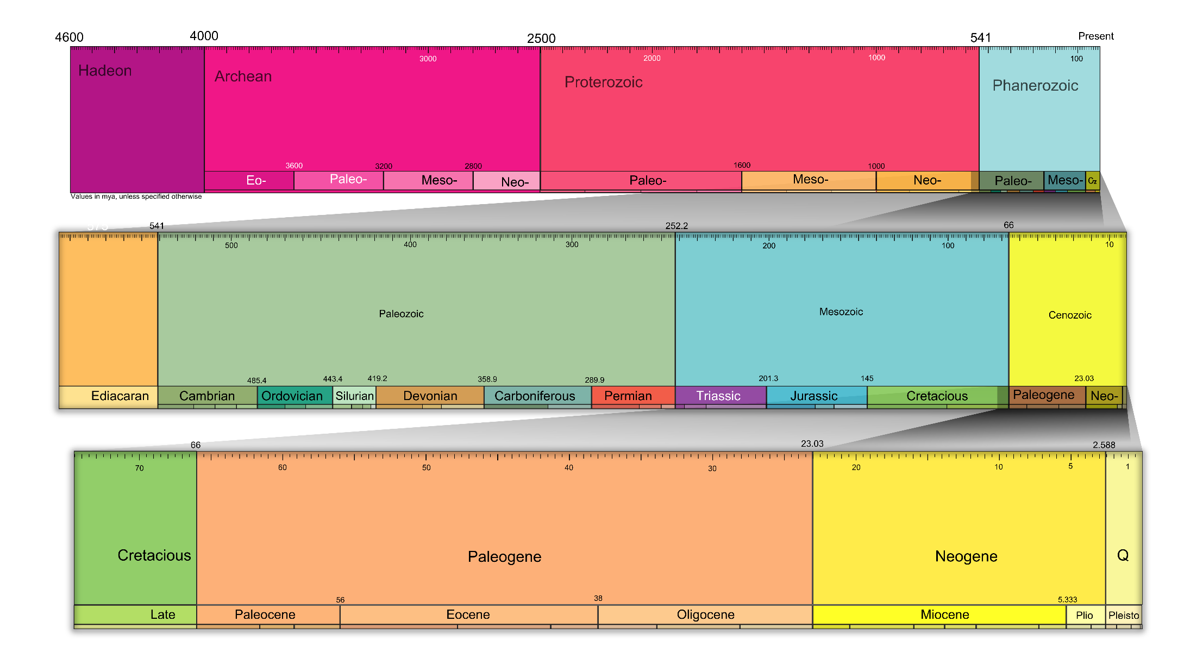
Meaning
Model
Data

Slide 13
Dynamic Reporting
Meaning
+
Model
+
Data

Slide 14
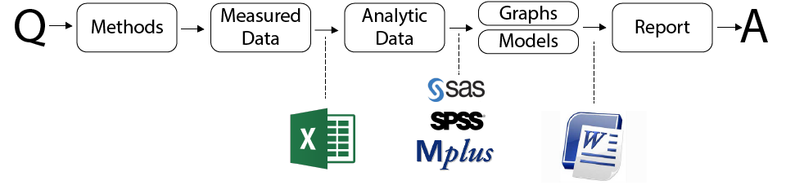

Slide 15
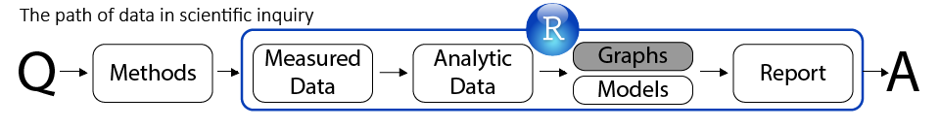

Slide 16
Skillset
Toolbox
R
Data Manipulation
RStudio
Statistical Modeling
Git
Graph Production
GitHub
Dynamic Reporting

Slide 17
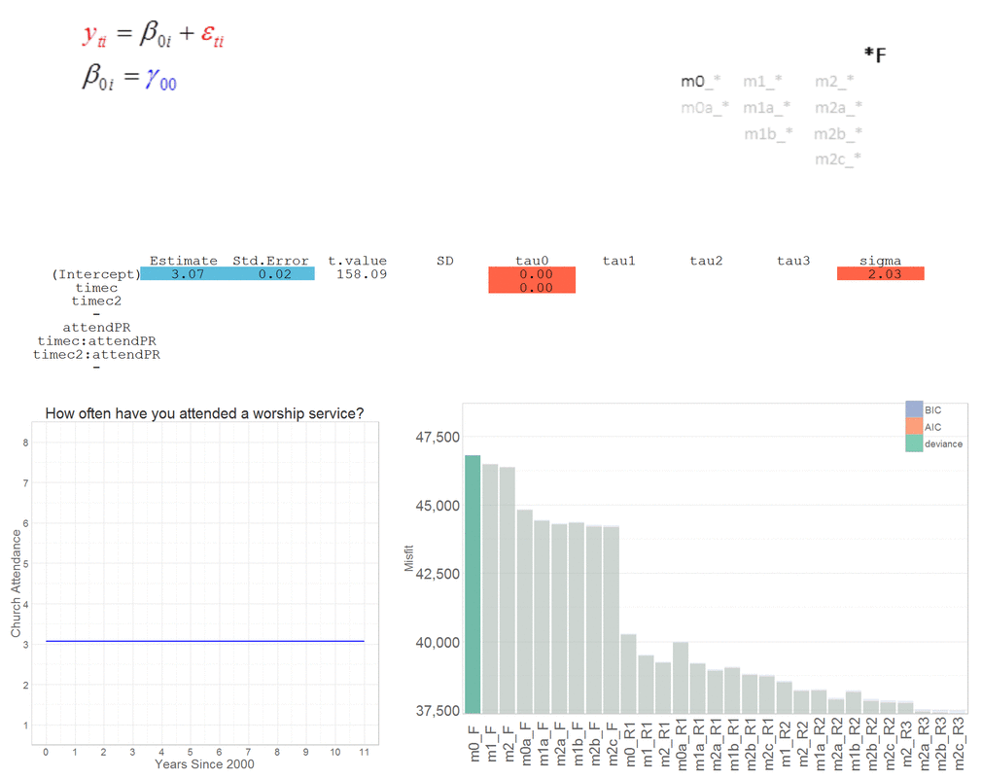
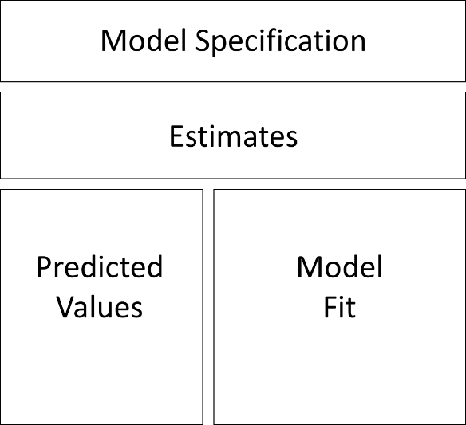
Prototype of a model sequencer

Slide 18

Interface for flying
Operations with concepts of
speed, azimuth, yaw, roll, pitch
Interface for modeling
Operations with concepts of
fit, significance, parsimony
?

Slide 19
Specification
Evaluation
Communication
Meaning
How do models comprise a meaning?
Model
How do variables comprise a model?
Data
How do data comprise the variable?
Algebra
Code
Within
Among
Print
Web

